Slide 1
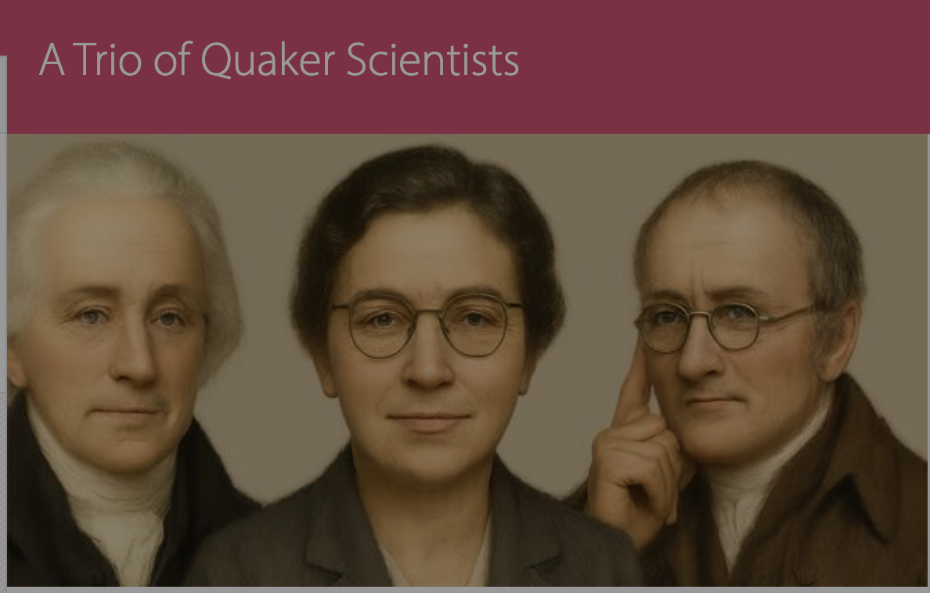
William Allen, Kathleen Lonsdale, John Dalton
Graham Waterhouse and Peter Murray-Rust
Copyright: Both Graham and Peter have liberal approaches to copyright (CC BY)

Slide 2
About these slides
Copyright. Wherever possible we have used CC BY (SA) material, especially
from Wikimedia. Other quoted material is offered as “personal use or non-commercial”.
We suggest you treat this set of slides as CC BY-NC
Repository. These slides and associated material is at
https://github.com/petermr/quaker_scientists
Use of AI. CursorAI (2025-09) has been used to gather information, primarily
from Wikipedia. I have checked most of it for accuracy but there may be slight errors
Knowledge Graphs. These have been created by CursorAI and I am continually revising
The protocol. There may be errors
Copyright: Both Graham and Peter have liberal approaches to copyright (CC BY)

Slide 3
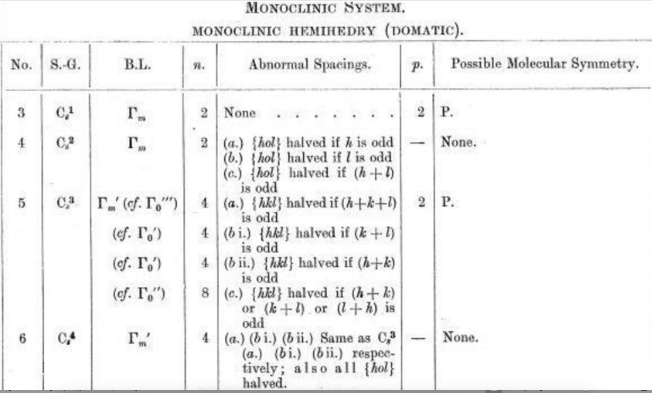

Slide 5
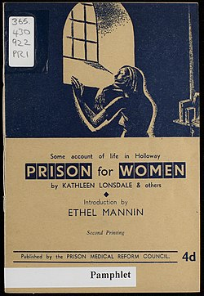
Pamphlet written by Kathleen Lonsdale on Prison Reform in 1943
After beginning her research career, in 1927 Yardley married Thomas Jackson Lonsdale. They had three children – Jane, Nancy, and Stephen. Stephen became a medical doctor and worked for several years in Nyasaland (now Malawi).^{[citation needed]}
Lonsdale was a vegetarian and teetotaller.^{[1]}
Pacifism
Though she had been brought up in the Baptist denomination as a child, Kathleen Lonsdale became a Quaker in 1935, simultaneously with her husband. Already committed pacifists, both were attracted to Quakerism for this reason.^{[36]} She was a Sponsor of the Peace Pledge Union.^{[37]}
She served a month in Holloway prison during the Second World War because she refused to register for civil defence duties or to pay a fine for refusing to register. During this time she experienced a range of issues which would eventually result in Lonsdale becoming a prison reform activist^{[38]} and she joined the Howard League for Penal Reform.^{[39]}
What I was not prepared for was the general insanity of an administrative system in which lip service is paid to the
Pamphlet written by Kathleen Lonsdale on Prison Reform in 1943
After beginning her research career, in 1927 Yardley married Thomas Jackson Lonsdale. They had three children – Jane, Nancy, and Stephen. Stephen became a medical doctor and worked for several years in Nyasaland (now Malawi).^{[citation needed]}
Lonsdale was a vegetarian and teetotaller.^{[1]}
Pacifism
Though she had been brought up in the Baptist denomination as a child, Kathleen Lonsdale became a Quaker in 1935, simultaneously with her husband. Already committed pacifists, both were attracted to Quakerism for this reason.^{[36]} She was a Sponsor of the Peace Pledge Union.^{[37]}
She served a month in Holloway prison during the Second World War because she refused to register for civil defence duties or to pay a fine for refusing to register. During this time she experienced a range of issues which would eventually result in Lonsdale becoming a prison reform activist^{[38]} and she joined the Howard League for Penal Reform.^{[39]}
What I was not prepared for was the general insanity of an administrative system in which lip service is paid to the

Slide 6
Knowledge Graphs for the scientists
Cursor AI was used to generate knowledge graphs of relatives, mentors/mentees

Slide 7
Knowledge Graphs for the scientists
Cursor AI was used to

Slide 8
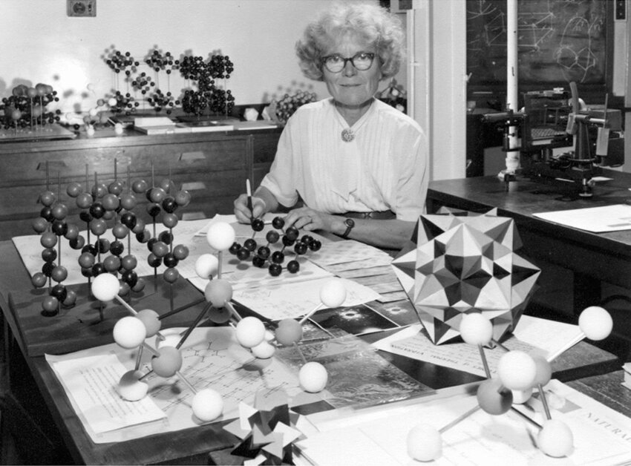
Kathleen Lonsdale in her crystallography research laboratory at UCL. Photographer and date unknown

Slide 9
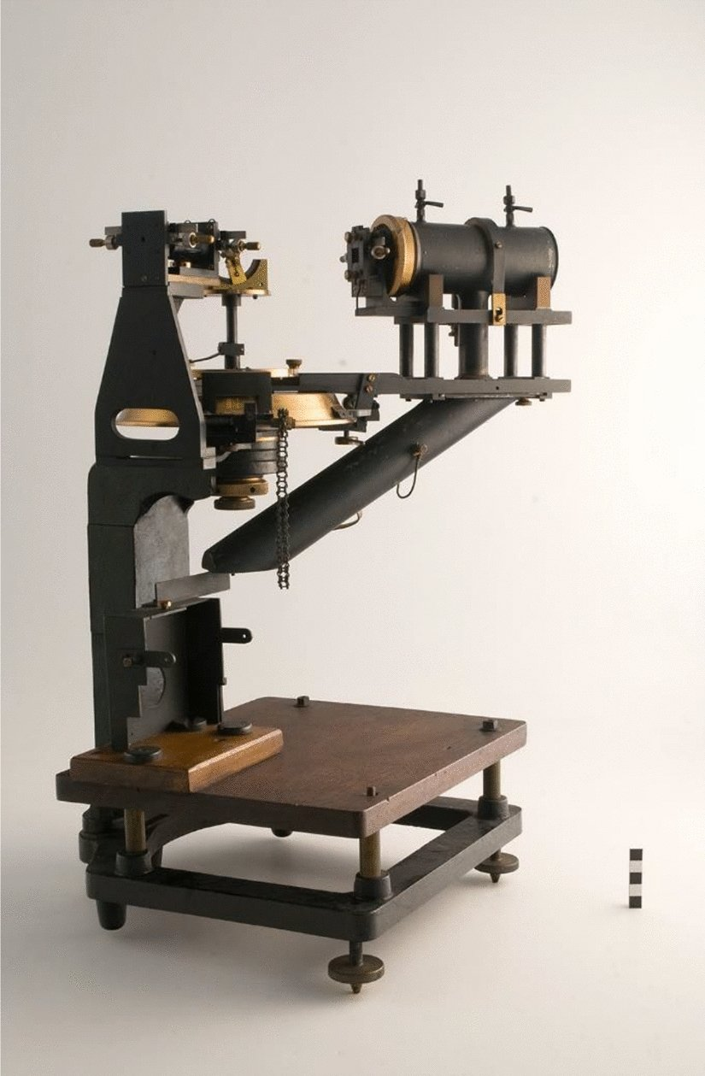

Slide 10

…another baby and I spent most of my time finishing off
(by hand, of course, using log tables) the Fourier analysis
of hexachlorobenzene. In view of the oft-repeated claims
of organic chemists that the crystallographers told them
nothing that they did not already known, it may be
interesting to reprint a more generous tribute from
C. K. Ingold (dated 2 November 193 1).
‘Ever so many thanks for the reprint of your wonderful
paper on Hexachlorobenzene. I havejust been studying
it in the Royal [Society journals] but am very glad to
have it in a handy form. The calculations must have
been dreadful but one paper like this brings more
certainty into organic chemistry than generations of
activity by us professionals.’

Slide 11
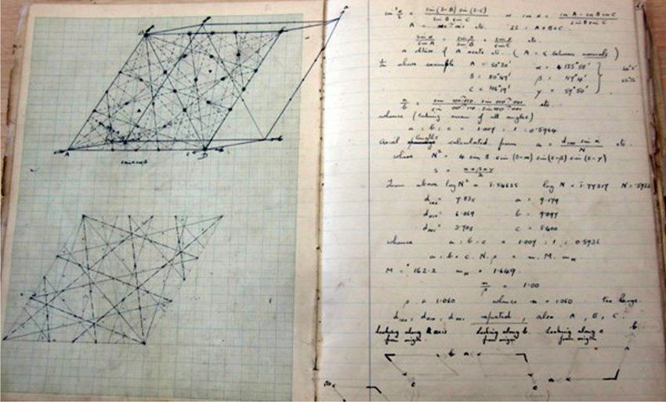

Slide 12
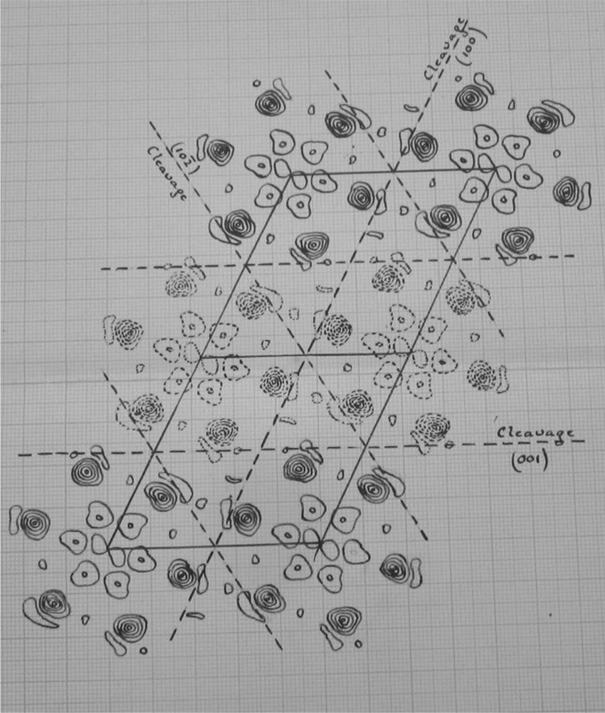
Drawing of the electron density projection on the (010) plane calculated for hexachlorobenzene. Extract from Lonsdale’s notebook labelled ‘1924’ Papers of Dame Kathleen Lonsdale UCL Special Collections. Courtesy: The Lonsdale family

Slide 13
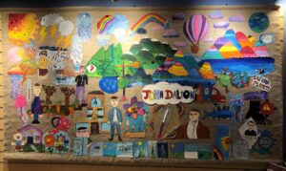
https://www.quaker-tapestry.co.uk/2021/03/19/john-dalton-scientist-quaker-and-pioneer/

Slide 14
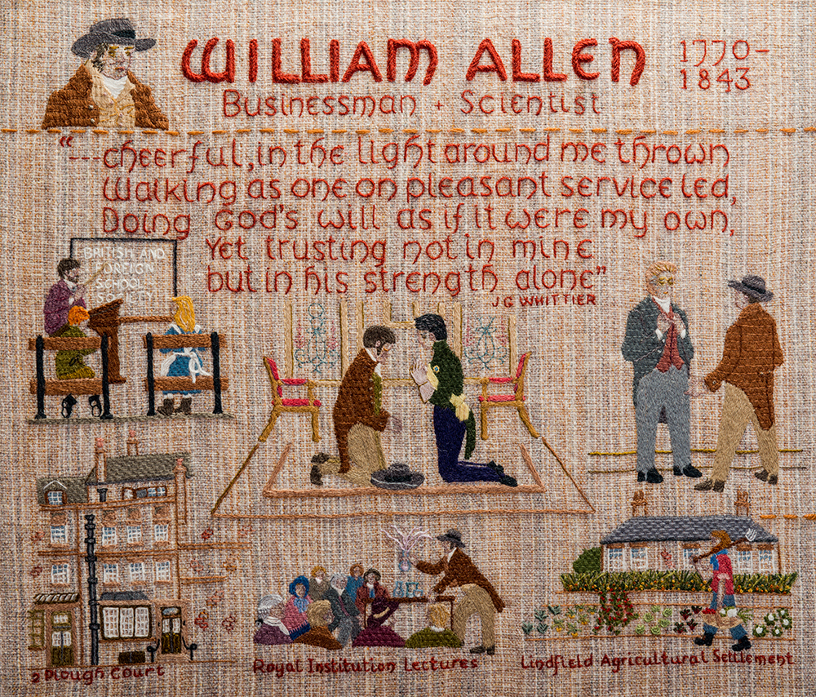

Slide 15
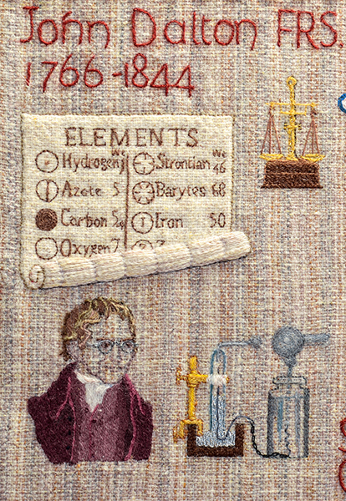

Slide 16
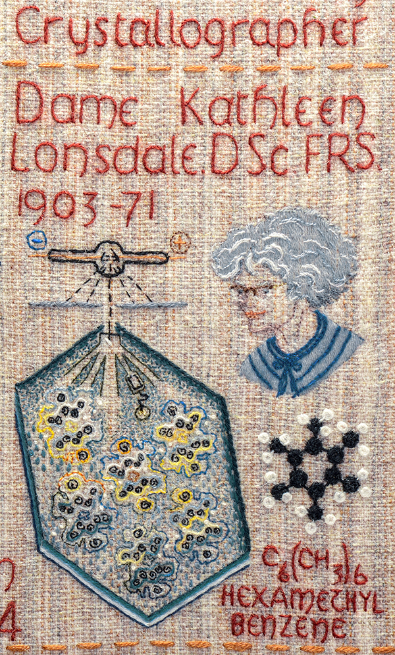

Slide 17
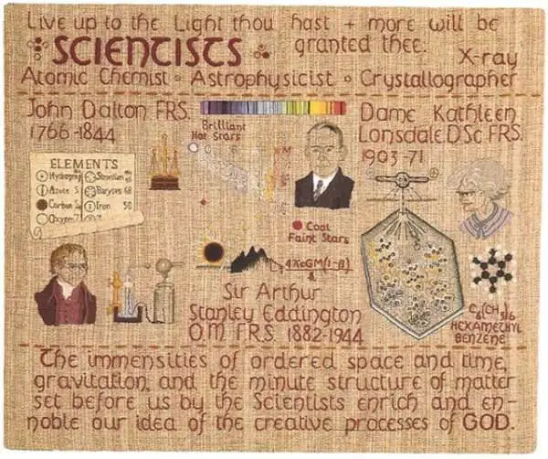

Slide 18
* Quaker principles
* How does PMR reconcile science and Quakerism
What was the scientific background at the time?
What were quaker networks, schools and industry
STEP
Effect of dissension

Slide 19
The finding of one generation will not serve for the next. It tarnishes
rapidly except it be reserved with an ever-renewed spirit of seeking.
Arthur Eddington

Slide 20
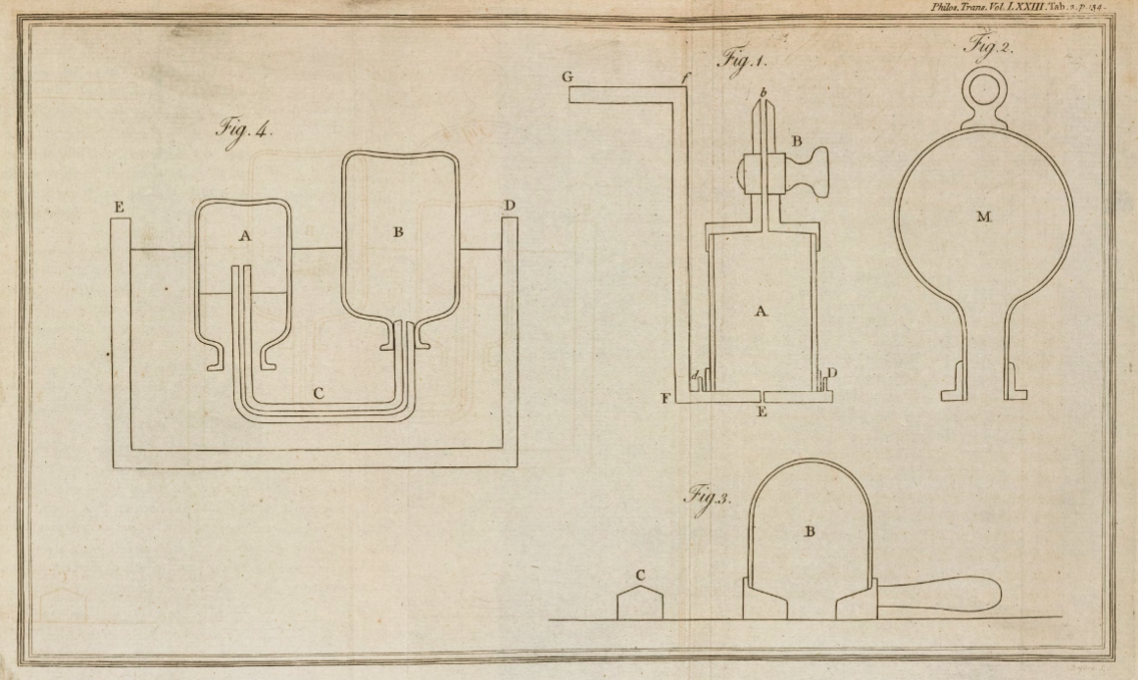
Scanned images copyright © 2017,
Royal Societyhttps://doi.org/10.1098/rstl.1783.0008open_in_new

Slide 21
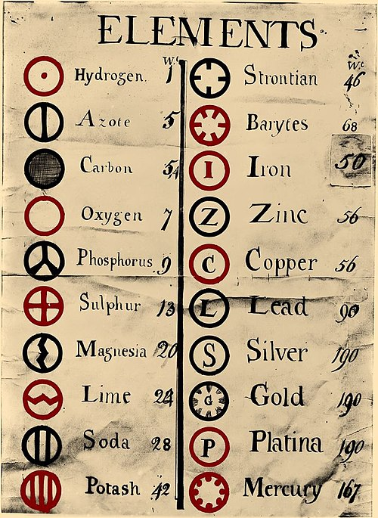
https://upload.wikimedia.org/wikipedia/commons/0/0f/Dalton%27s_Element_List.jpg

Slide 22
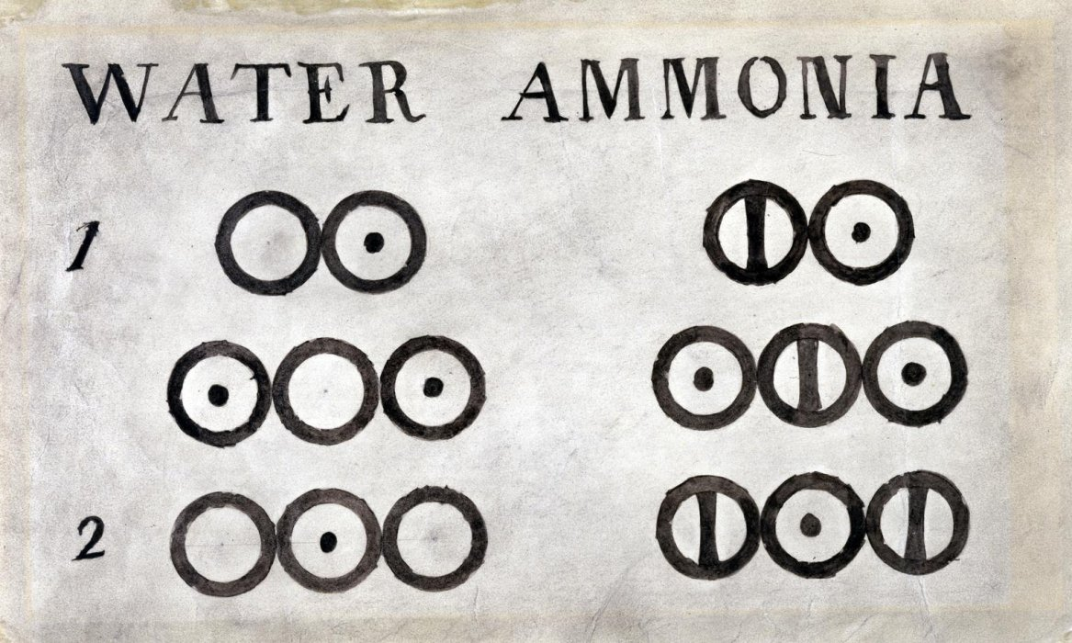

Slide 23
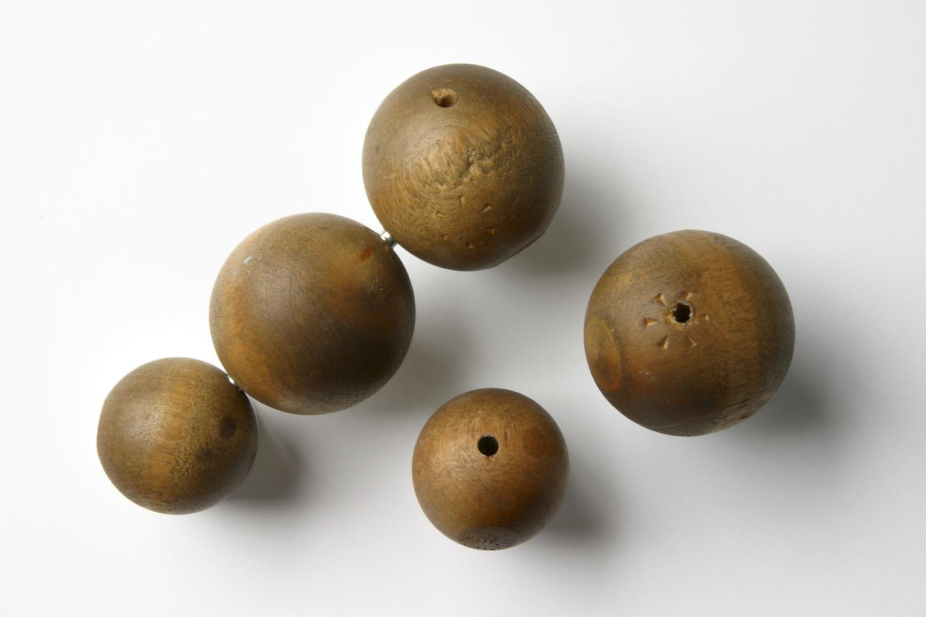
Five wooden balls, made by Peter Ewart of Manchester c.1810, and used by John Dalton for demonstrating his atomic theory c. 1810–42
Science Museum Group Collection

Slide 24
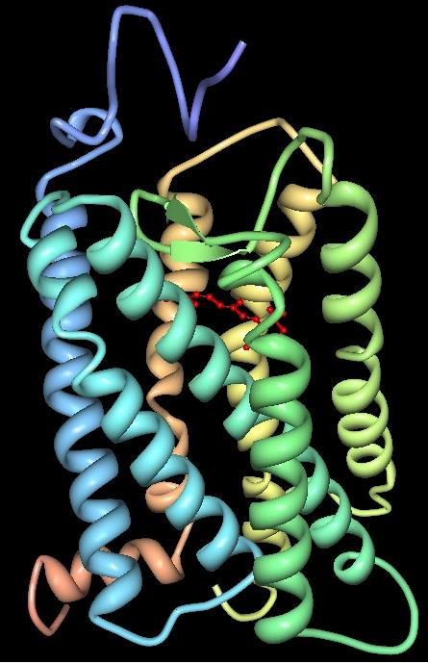
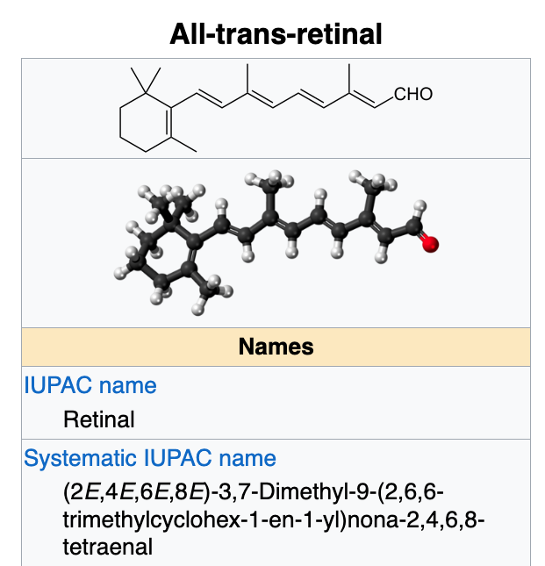
Atoms responsible
for John Dalton’s
colour blindness
https://en.wikipedia.org/wiki/Vertebrate_visual_opsin
Three-dimensional structure of bovine rhodopsin. The seven transmembrane domains are shown in varying colors. The retinal chromophore is shown in red. Wikipedia

Slide 25
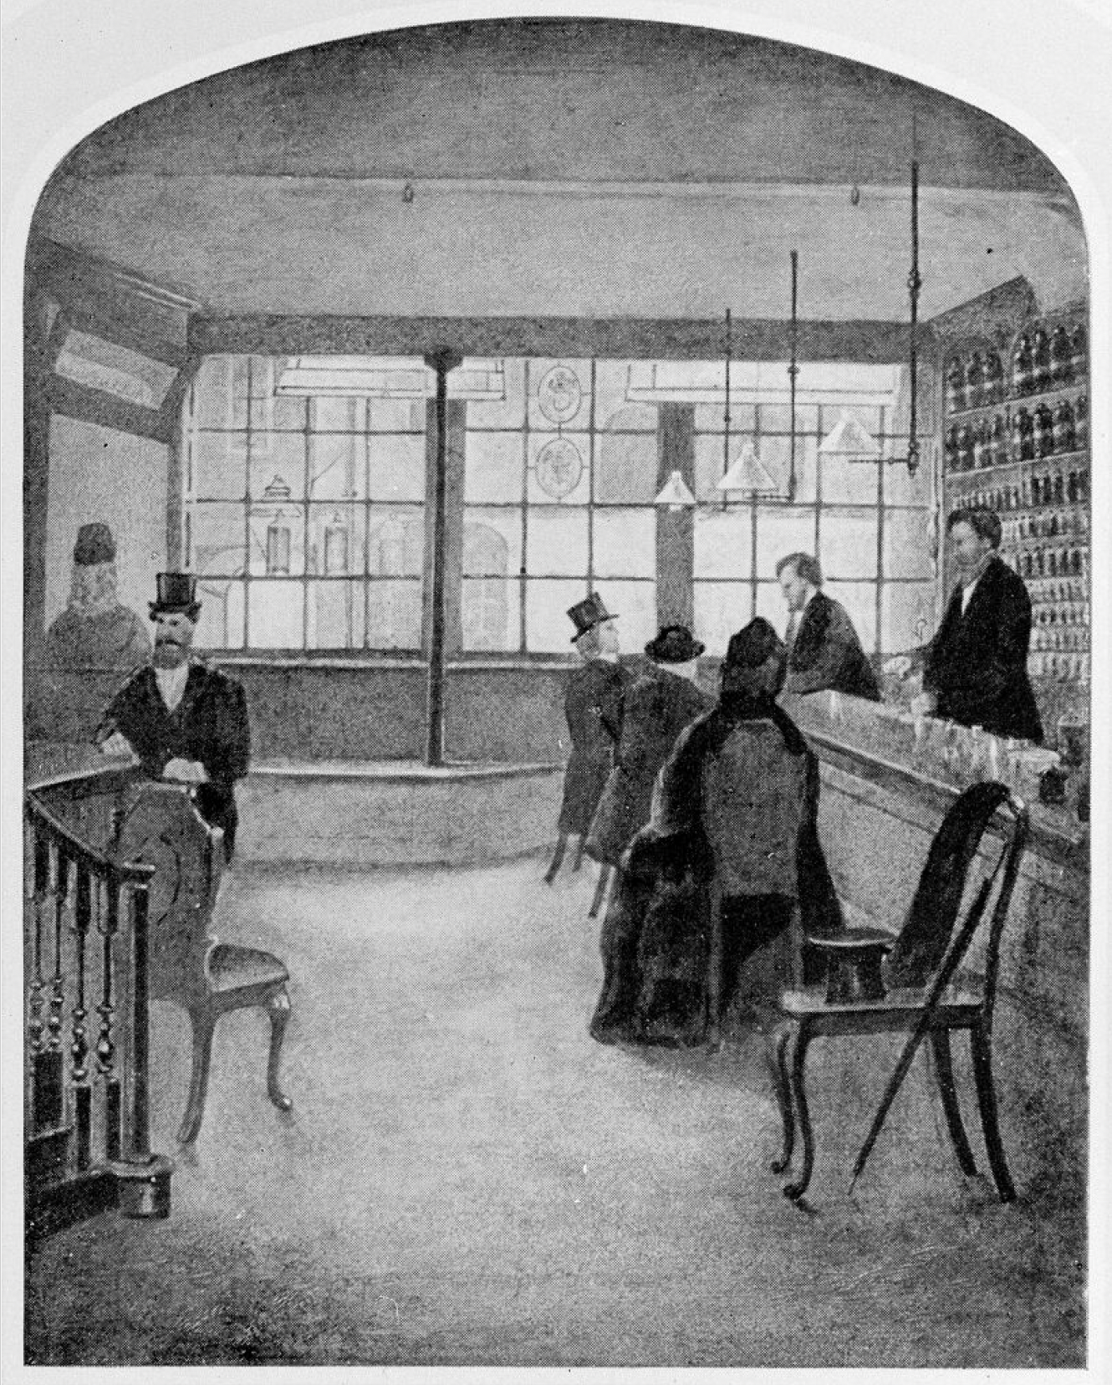
Wellcome Trust Corporate Archive
…Direct activities WT/D
Library and Museum WT/D/1
Images from the photographic library WT/D/1/20M0007729:
Interior of the old pharmacy at Plough Court WT/D/1/20/1/66/62

Slide 27
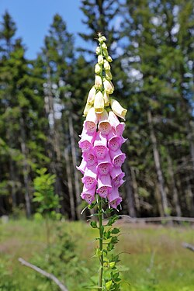
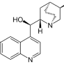
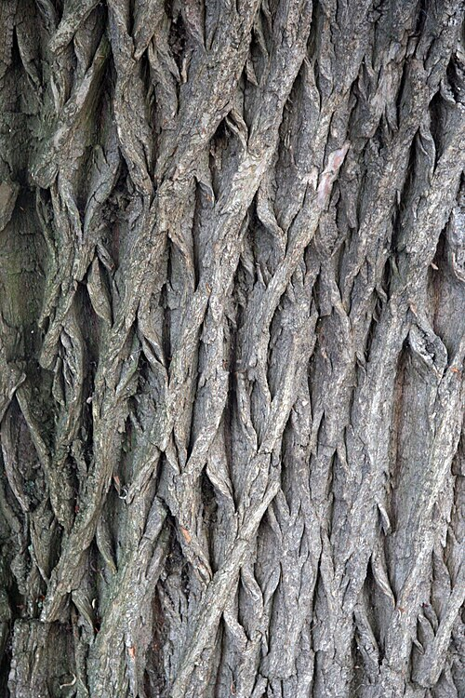
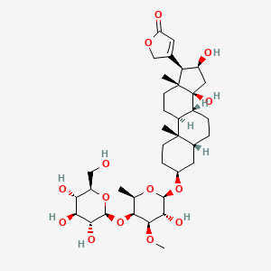
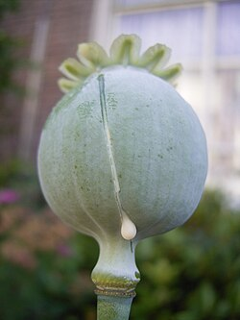
Plough Court Pharmacy Medicines (1715-1927) [from CursorAI]
NATURAL:
Digitalis (Foxglove): For heart conditions
Willow Bark: Pain relief and fever reduction (precursor to aspirin)
Quinine powder: Malaria treatment
Chamomile: Digestive issues and anxiety
Peppermint: Valerian: Rose Water:
Laudanum: Opium tincture for pain relief and coughs
Elixirs, Cordials, bitters
Chemical Compounds
Mercury compounds: For syphilis treatment
Calomel (mercurous chloride): Purgative
Antimony: Emetic and purgative
Arsenic preparations, Lead acetate
Sulfur preparations: For skin problems
Zinc oxide ointments: For wounds and burns
Bottles, Scales, equipment, Mortars and pestles, Distillation equipment
Pills and powders: Lozenges:

Slide 28
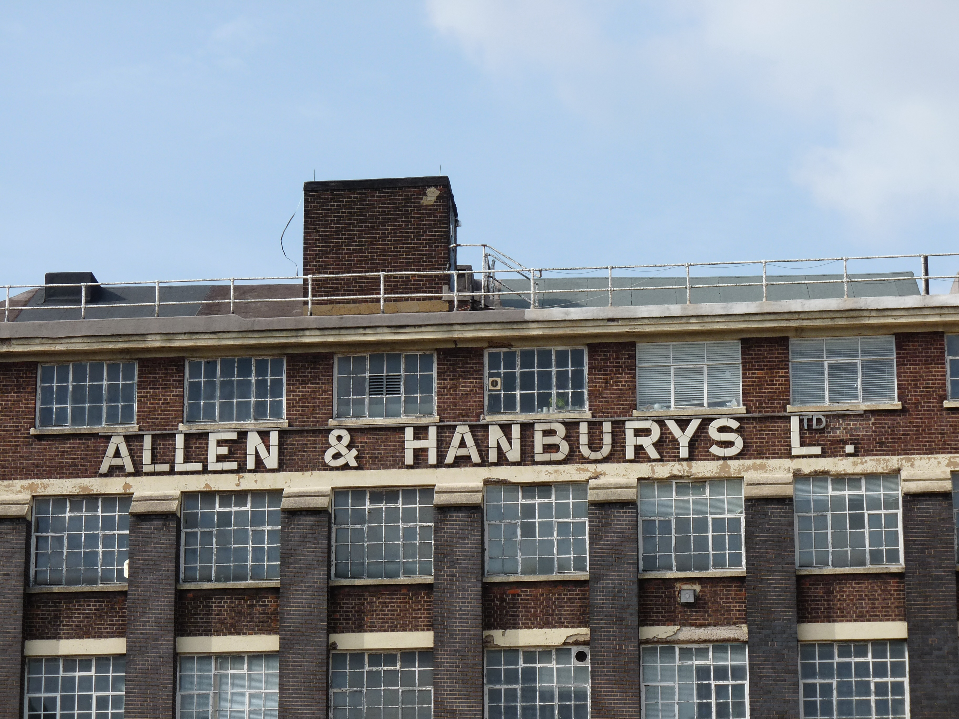

Slide 29
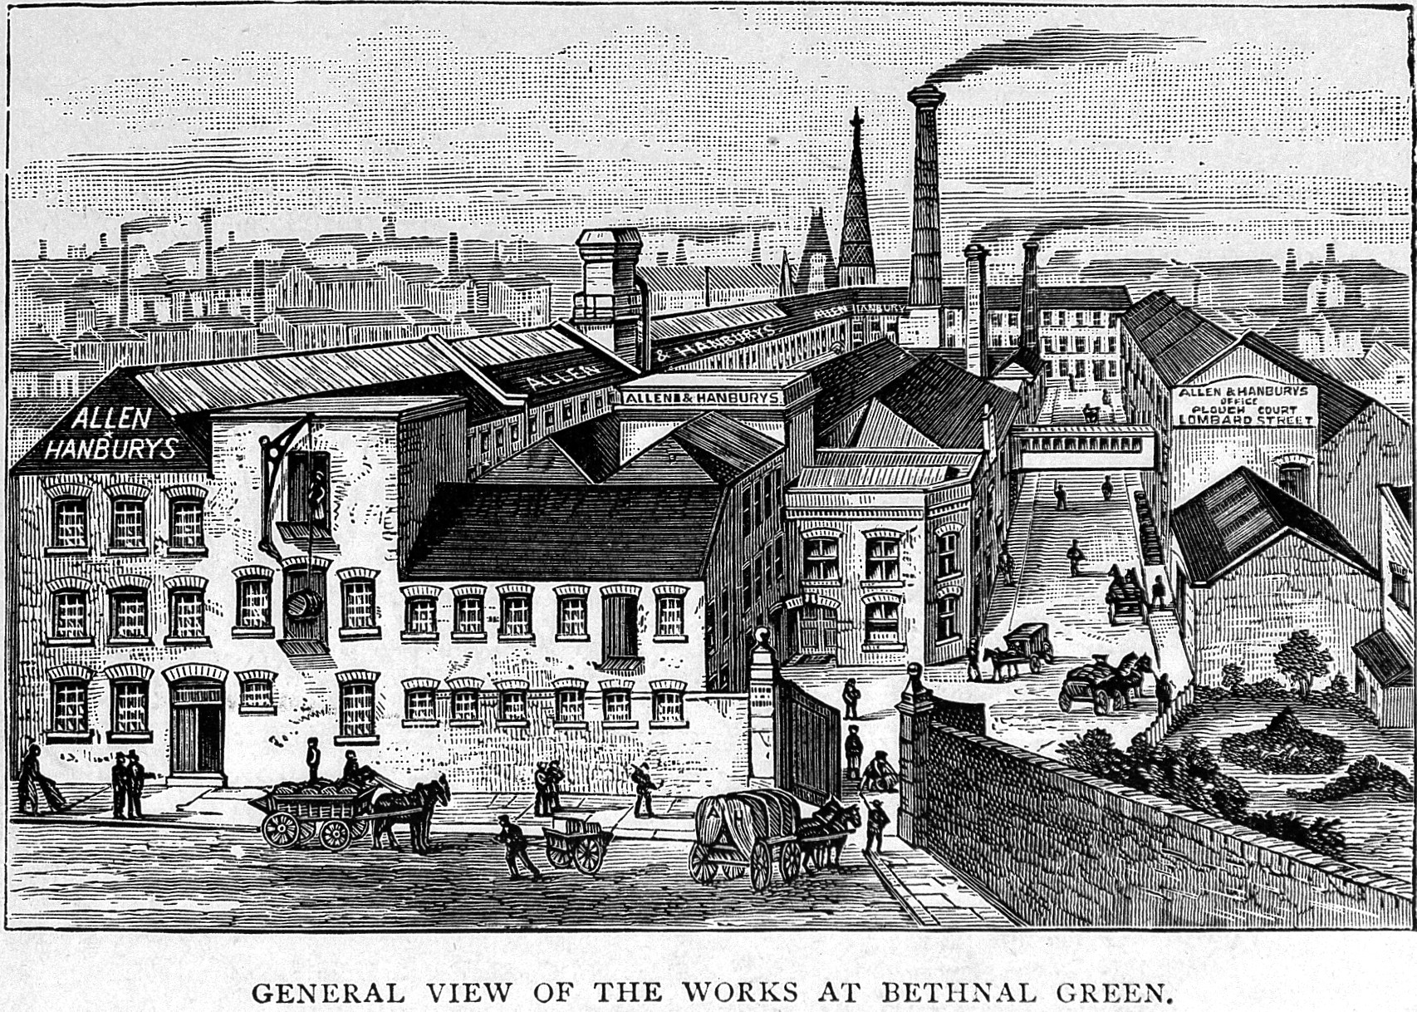
Creator: Wellcome Library, London
Copyright: Copyrighted work available under Creative Commons Attribution only licence
CC BY 4.0 http://creativecommons.org/licenses/by/4.0/

Slide 30
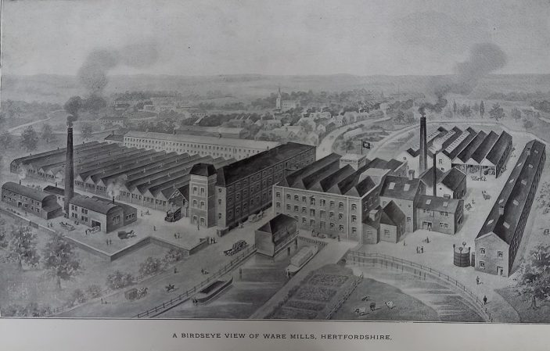
Allen & Hanbury's, Ware showing the factory and mills in 1920
Hertfordshire Archives & Local Studies (Ware.Industries pamphlet file)

